Slide 1
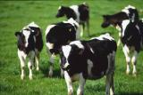


Correlation of transcriptomic and phenotypic data in dairy cows.
Zaneta Park, David Pacheco, Neil Cox,
Alan McCulloch, Russell Smithies,
Richard Spelman, and Sue McCoard
This research has been funded through AgResearch Internal Investment
Notes:
Livestock Improvement Corporation

Slide 2
The data…
An awesome data set as both gene expression and phenotypic data available for ~ 350 dairy cows.
Our objective was to determine if any genes had expression that was significantly correlated with any of the phenotypes.
Essentially a data-mining exercise, however because of the large number of samples, it seemed likely that any such correlations would truly represent an association between the gene and phenotype.
Notes:
Many thanks to Livestock Improvement Corporation for the use of their data ☺
… last paragraph: as opposed to being a false positive…

Slide 3
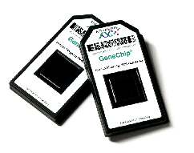
Affymetrix microarray data…
Fat and liver samples taken by biopsy
Run on an Affymetrix Bovine genome chip comprising 24128 genes
Data normalized using Robust multi-chip averaging (RMA)
‘Present’, ‘Marginal’ and ‘Absent’ calls calculated for each gene on each chip. Only ‘Present’ genes used in further analyses.
Data log-transformed
Notes:
RMA consists of a quantile-type normalization whereby essentially the genes are ranked on each chip, the average distribution across all chips determined, and then the individual distributions on each chip changed to match the average distribution. (Further detail: it consists of three steps: a background adjustment, quantile normalization and finally summarization.)
MAS5 uses a non-parametric statistical test (Wilcoxon signed rank test) of whether significantly more perfect matches show more hybridization signal than their corresponding mismatches to produce the detection call (Absent (A), Present (P) or Marginal (M)) for each probe set

Slide 4
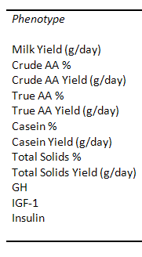
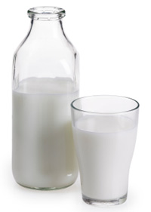
Phenotypic data…
Data for 13 phenotypic variables was available:
Milk yield and composition
Endocrine: these variables also log-transformed
Somatic cell count
Notes:
Phenotypic data available for 13 variables for each cow ☺
Looking at the variability of each variable, the endocrine variables and scc were also log transformed before analysis to enable homogeneity of variance across the range of values for each of these variables. (maybe don’t mention yet as will describe on the Excel spreadsheet slide…)

Slide 5
Data cleaning…
Size of dataset allowed us the luxury of subsetting it
to the very best data ☺
… thus increasing our chances of finding interesting, real correlations.
For example:
Only cows with phenotypic data recorded within +/- 2 days of the fat and liver biopsies were used to make sure that the relationship between the gene expression and phenotype data was as strong as possible.
Only cows biopsied on day 28 post calving were used, to minimize variability in the dataset due to stage of lactation.
Only cows that were milked twice daily through the season were used to minimize potential variability in the dataset due to frequency of milking effects.
Notes:
Only using cows that were milked twice daily through the season reduced the number of cows by about half.

Slide 6
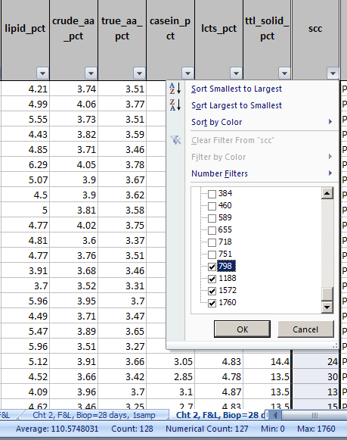
Data cleaning (cont)…
Additionally, the phenotype data was plotted and cows with unusual values were excluded [e.g. cows with mastitis]
Outliers were also detected using
Excel filters…
…and the Min-Max summaries at the bottom of the spreadsheet. These are also useful for detecting skewed data.
After subsetting the data to the required high quality data, 121 cows still remained
☺☺☺
Average = 110
Min = 0
Max = 1760
Notes:
Phenotype data (13 variables): were able to use Excel to check for outliers. Did these analyses with Sue (the scientist) sitting next to me, as she knows this type of data well and so knew which values indicate something was wrong with the cow. Only took a couple of hours to go through all of the data in this way.

Slide 7
Data analysis…
R used to do the analyses ☺
Raw microarray data files = 630MB!!
Linux used to run the analyses as Windows did not have enough memory!
PuTTY used to access Linux server from my Windows machine. = a terminal emulator i.e. provides a ‘window’ to the Linux server.
Xming is another tool for accessing a Linux server from your desktop. Has the advantage that also includes a graphics window.
Notes:
Whereas microarray data normalizations and correlation analyses run using R.
Due to the size of the microarray files, ran R using Linux. PuTTY/Xming – both very easy to use ☺ Can run analyses in up to 5-6 PuTTy windows at once. Xming also provides a graphics window.
Putty and Xming: These protocols are all used to run a remote session on a computer, over a network. PuTTY implements the client end of that session: the end at which the session is displayed, rather than the end at which it runs.
(Or in really simple terms: you run PuTTY on a Windows machine, and tell it to connect to (for example) a Unix machine. PuTTY opens a window. Then, anything you type into that window is sent straight to the Unix machine, and everything the Unix machine sends back is displayed in the window. So you can work on the Unix machine as if you were sitting at its console, while actually sitting somewhere else.)
“…it is easy to conduct R sessions on the remote host using a standard terminal emulator such as putty, or via
an Xwindows based terminal program such as xterm. To run xterm you need a PC X server such as
Xming. An advantage of running an X Server is that you can then display graphical output from
your R session directly on your PC desktop”

Slide 8
Correlation analysis: gene expression versus phenotype…
Interested in finding genes which changed in expression with phenotype.
Started with a simple correlation analysis: Pearson correlations between all phenotype and gene combinations determined, using two FOR loops in R.
Number of combinations to test:
24128 genes x (13+4) phenotypes x 2 sample types = 820,352!
Using linux, R handled this comfortably in < 1 hour ☺
Notes:
FOR loops: one for genes and one for phenotypes. Sounds easy, and wasn’t too bad to do in R – around half an hour running time. About destroyed Excel though!! (though Neil eventually got this to work ☺ ).

Slide 9
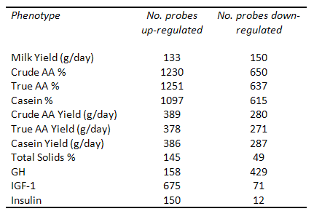
Correlation analysis: results…
Significantly correlated genes defined as: p-value < 0.05; fold change for 90th versus 10th percentile > 1.2; number of “Present” genes >100
Numbers looked reasonable:
Included 7 fat and 19 liver genes in the mTOR signalling pathway, which was within the bounds of expectation ☺
Notes:
FOR loops: one for genes and one for phenotypes.

Slide 10
Visualization of the results…
Difficult to graphically show the results for 820,352 gene-phenotype combinations at once!
However, can use Excel tools and functions to make it easy to plot the relationship for any gene-phenotype combination…
Drop-down boxes using Data>Validation
MATCH
OFFSET
Notes:
Scientist familiar with using Excel, so seemed a good tool to use.

Slide 11
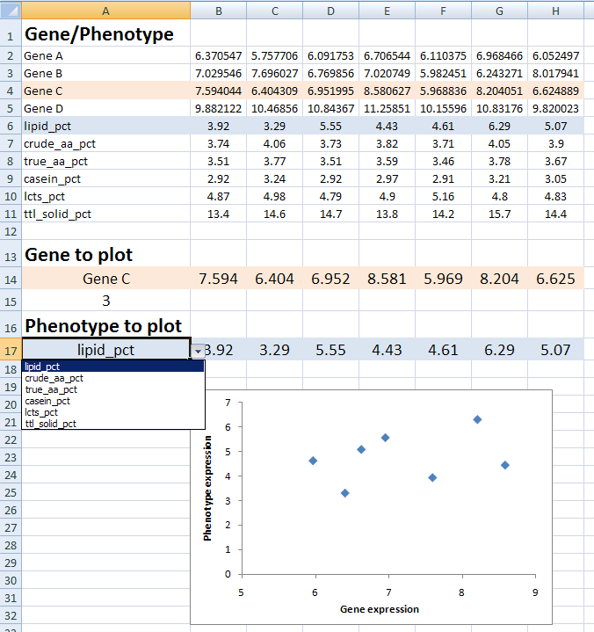
Visualization of the results…
Use MATCH to determine where the chosen gene and phenotype occur in the data
Gene/Phenotype data
Type in the name of the gene to plot
Use OFFSET and the MATCH result to obtain the data for the required gene and phenotype
Select the phenotype from the drop-down list – this list created using Data>Validation

Slide 12
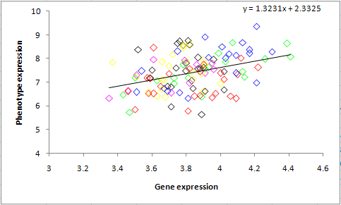
Summary…
Many good looking correlations seen ☺
Visually, sire effects don’t appear to be large, however currently testing this using mixed effects regression.
Having such a large dataset is an extremely valuable resource to NZ
Notes:
If time, talk more about the more complicated approach incorporating sire info too..
Also, talk about columns and the difficulties in reading data with multiple columns back into R! (use scan, transpose data, define column classes all useful tricks…)
[Check length of talk currently to determine whether to add these 2-3 slides as well.]

Slide 13
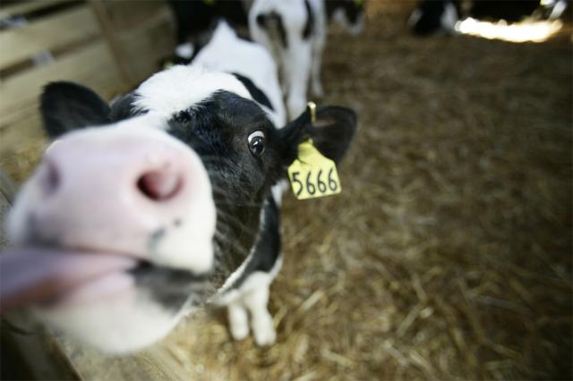
Thank-you

